Slide 1
Harvard Artifacts Explorer
By Anubriya Baskaran
Project Submission

Slide 2
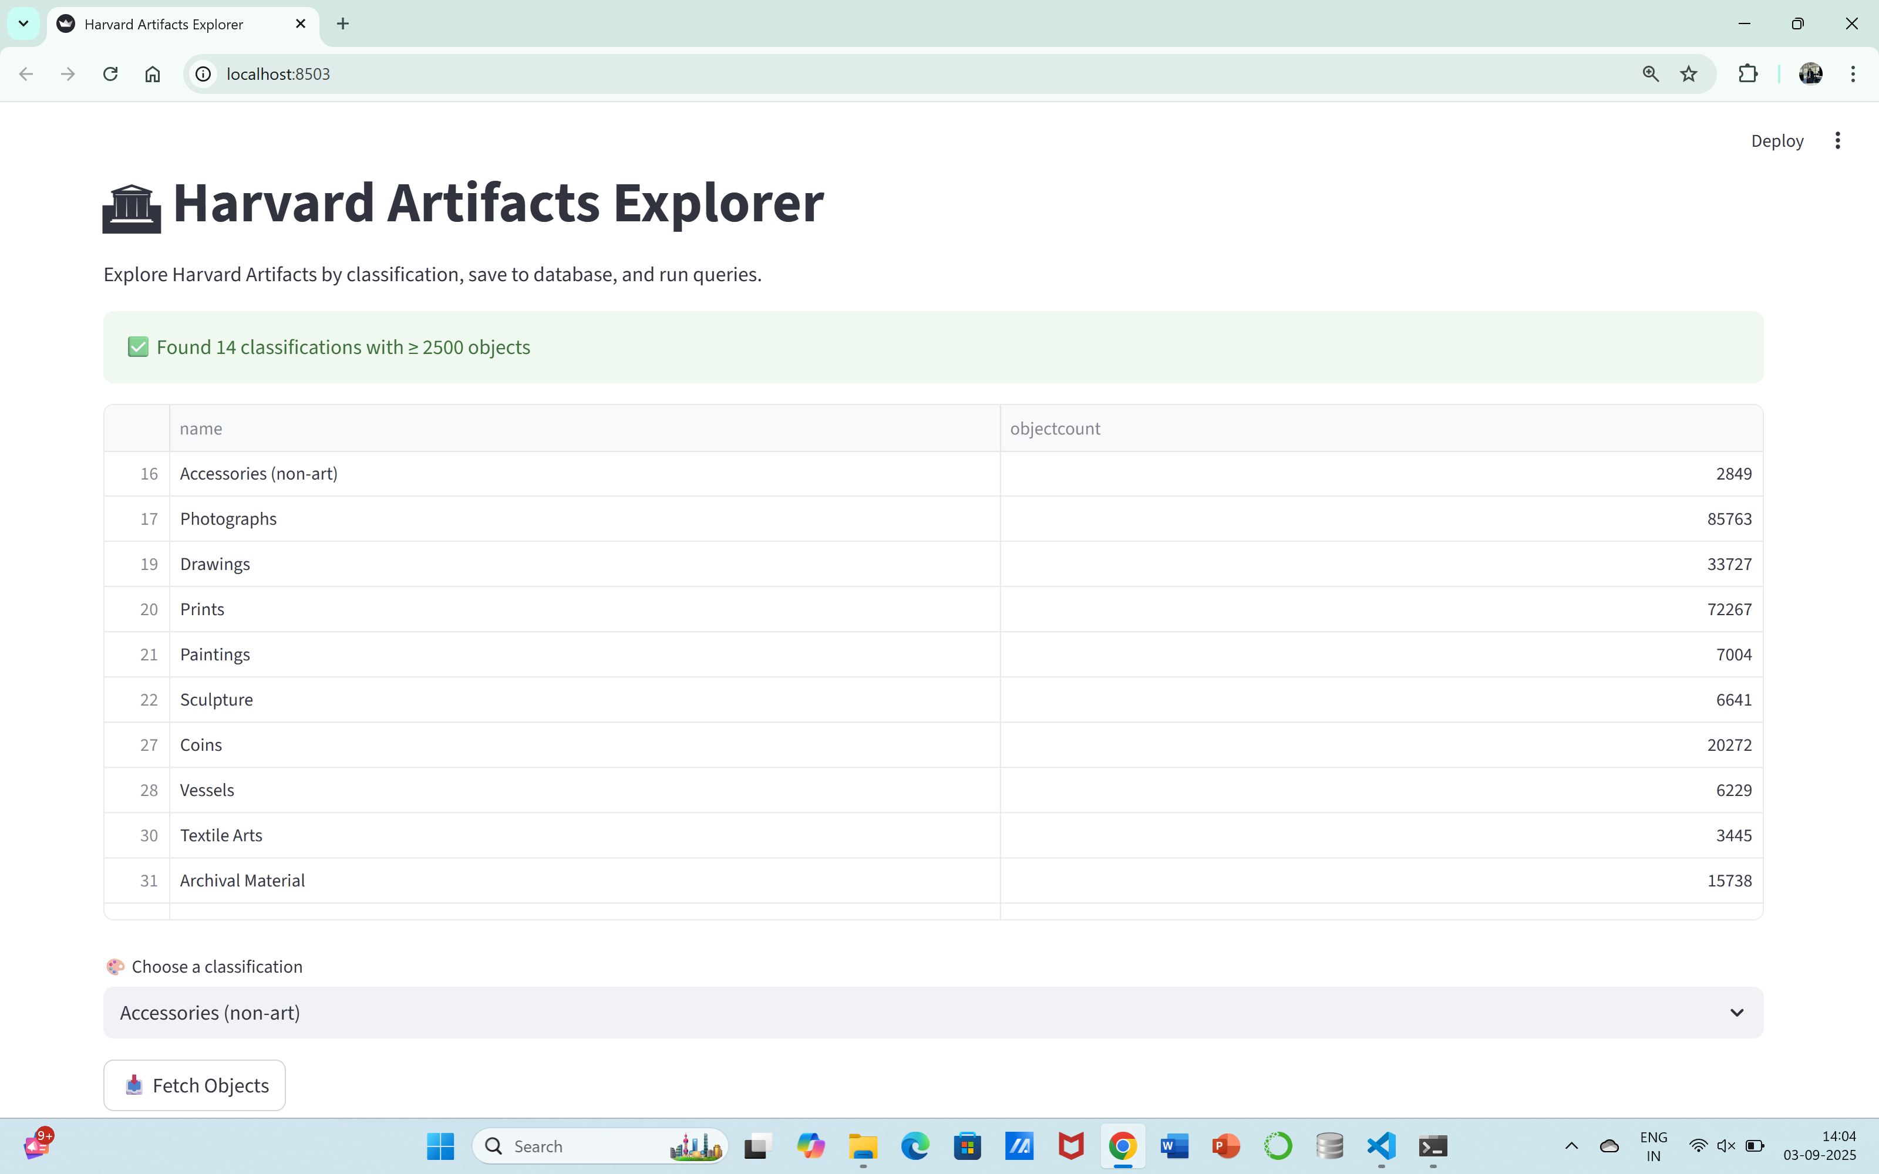
Introduction
This project explores the Harvard Artifacts dataset using the Harvard Art Museums API. It fetches artifact classifications, allows users to insert data into an SQLite database, and execute SQL queries via a Streamlit interface.

Slide 3
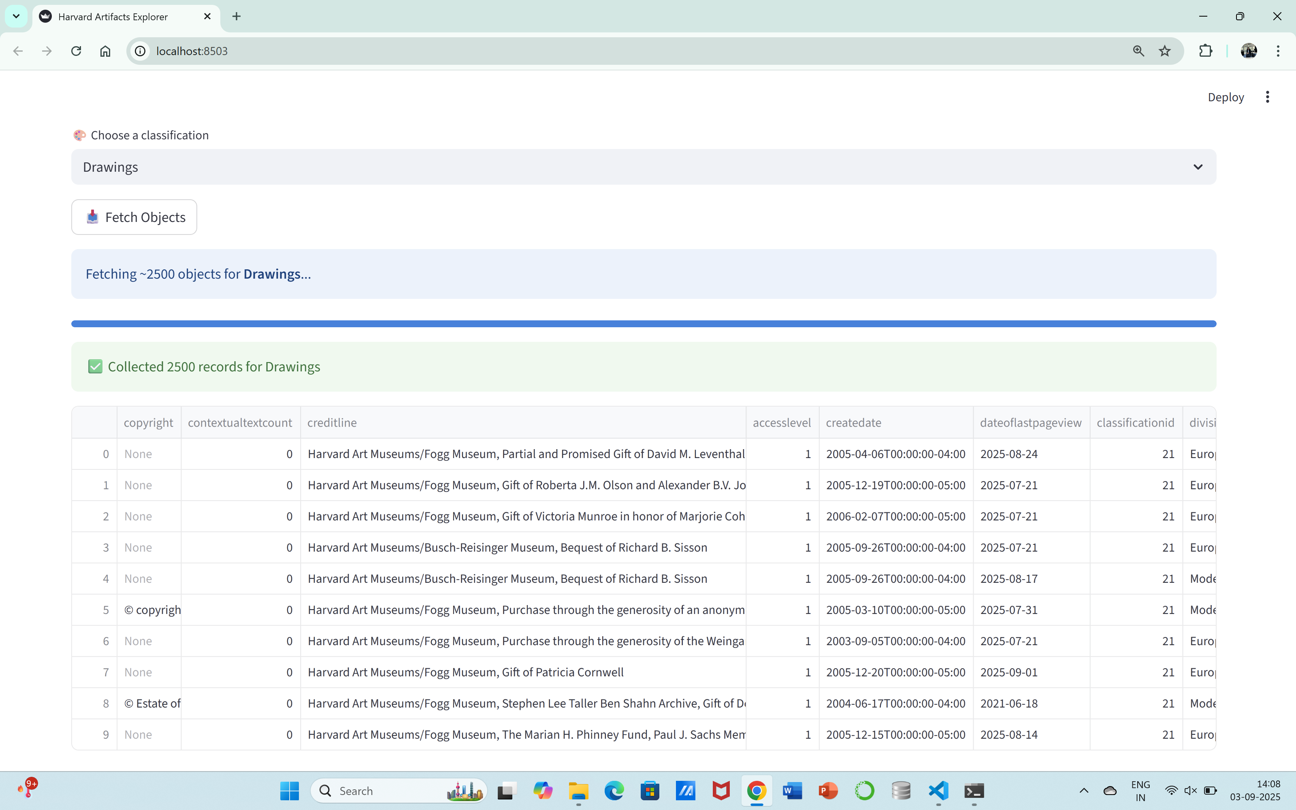
Objectives
Fetch and display artifact classifications
Store metadata, media, and colors in SQLite
Allow users to insert new records
Provide a SQL query explorer with 30 queries
Derive insights with DIY queries

Slide 4
Tools and Technologies Used
Programming Language: Python
Framework: Streamlit
Database: SQLite
API: Harvard Art Museums API
Libraries: pandas, requests, sqlite3, time
Documentation Tools: MS Word, MS PowerPoint

Slide 5
System Architecture
Data is fetched from the Harvard Art Museums API.
Data is filtered to select only classifications with more than 2500 objects.
Selected classifications are explored by fetching artifacts (metadata, media, colors).
Data is stored in SQLite tables (artifact_metadata, artifact_media, artifact_colors).
Users interact via Streamlit interface to insert, query, and visualize data.

Slide 6
Database Design
Table 1: artifact_metadata
Stores general metadata such as title, culture, period, century, medium, department, classification, etc.
Table 2: artifact_media
Stores media-related data such as imagecount, mediacount, colorcount, rank, and date ranges.
Table 3: artifact_colors
Stores extracted colors, hues, coverage percentages, and CSS3 representations.

Slide 7
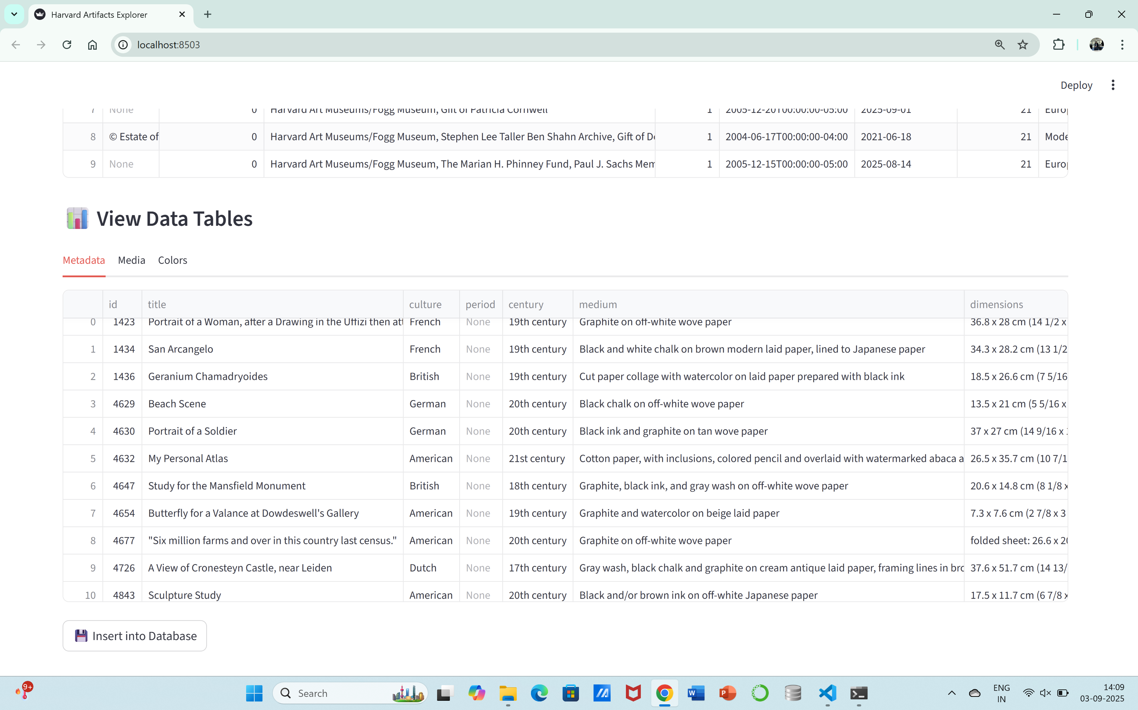
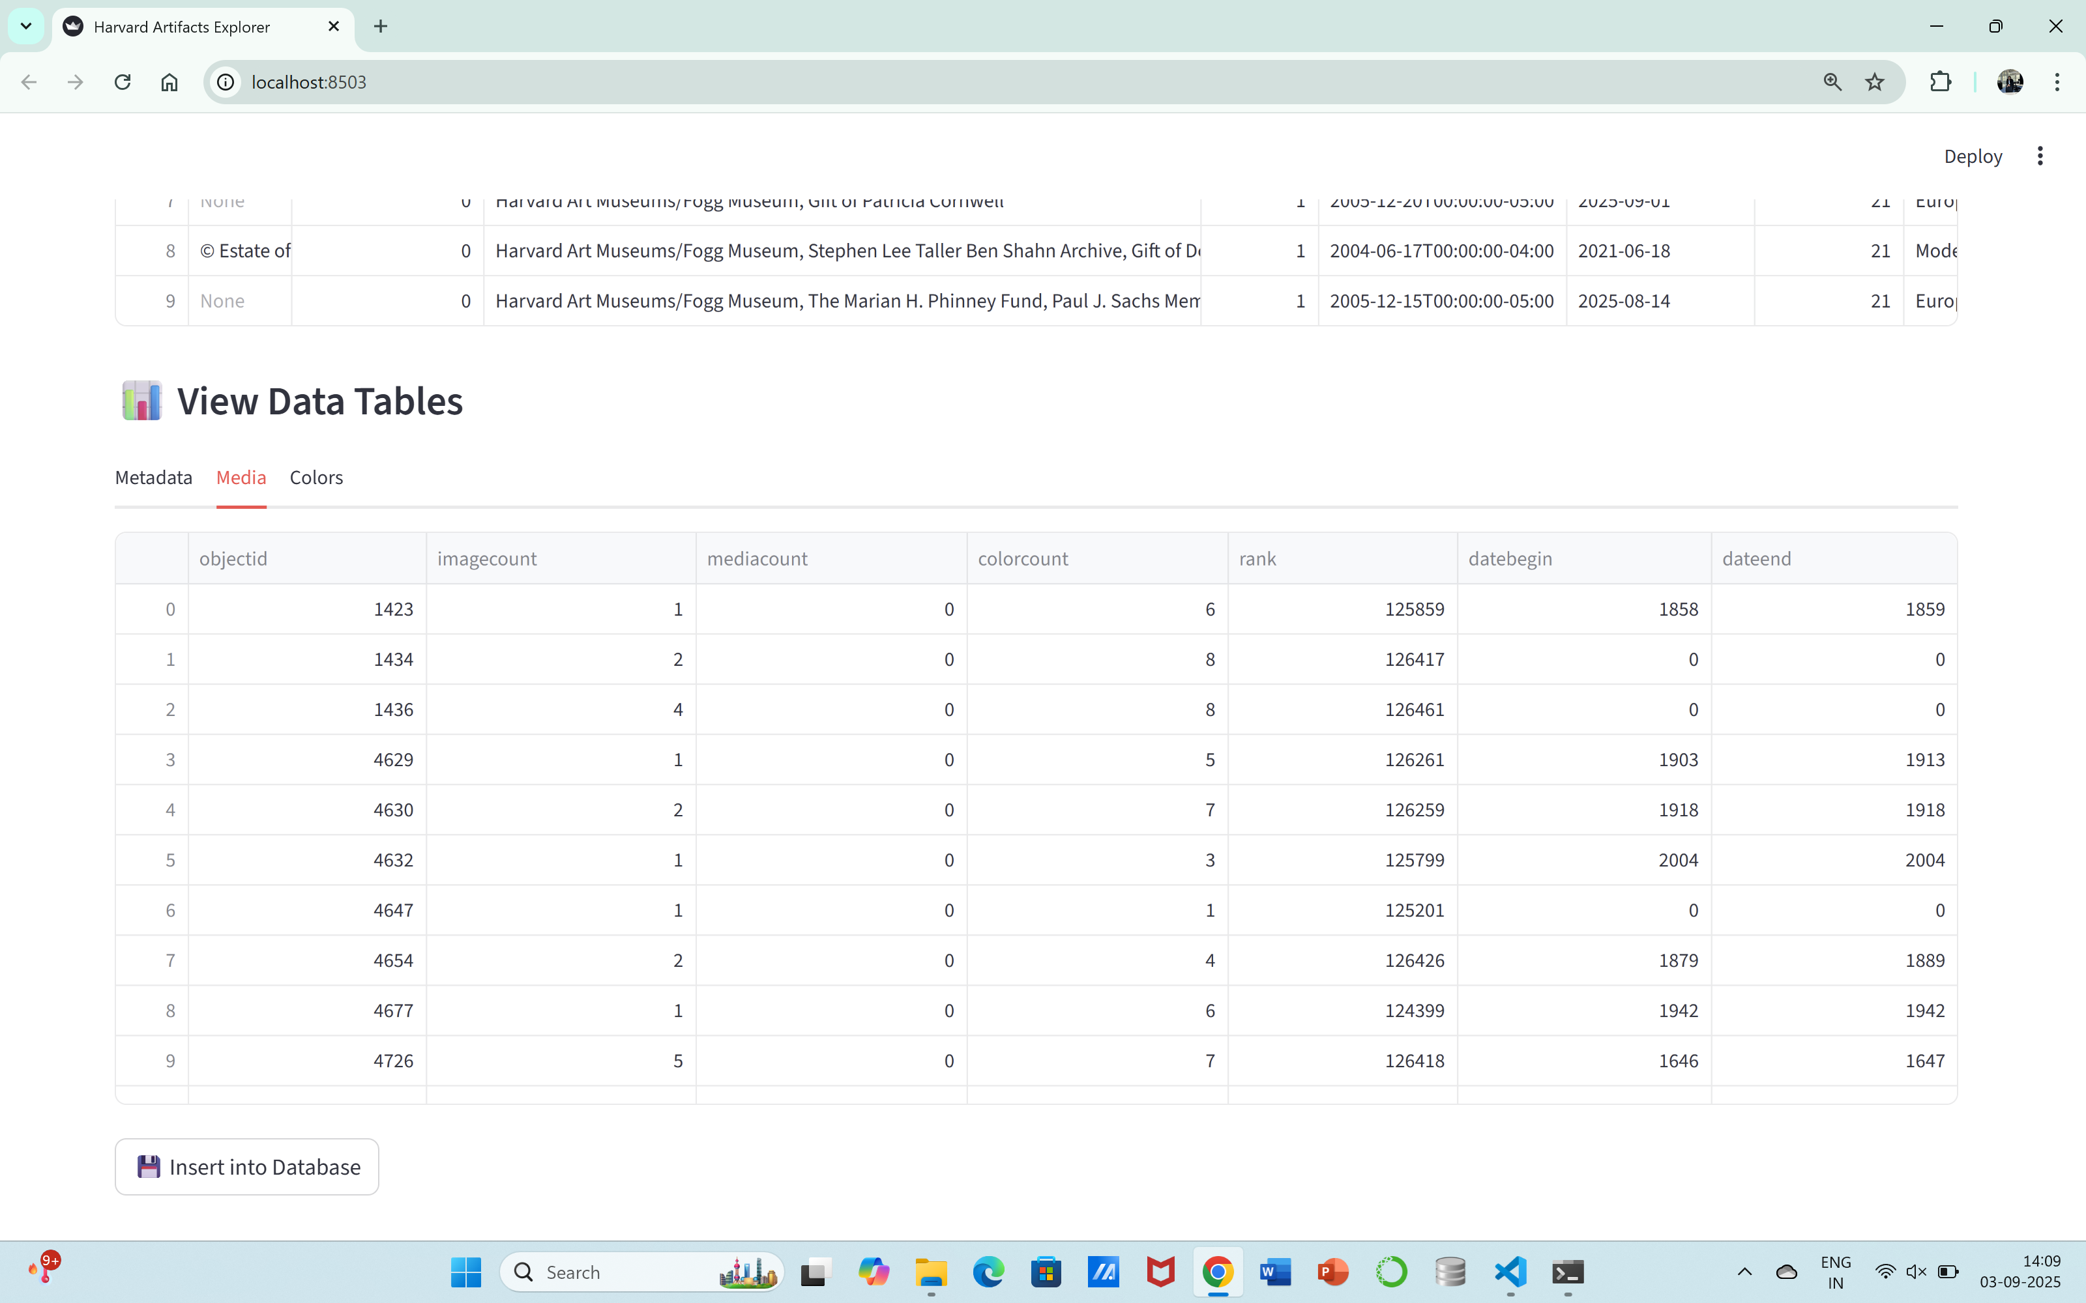
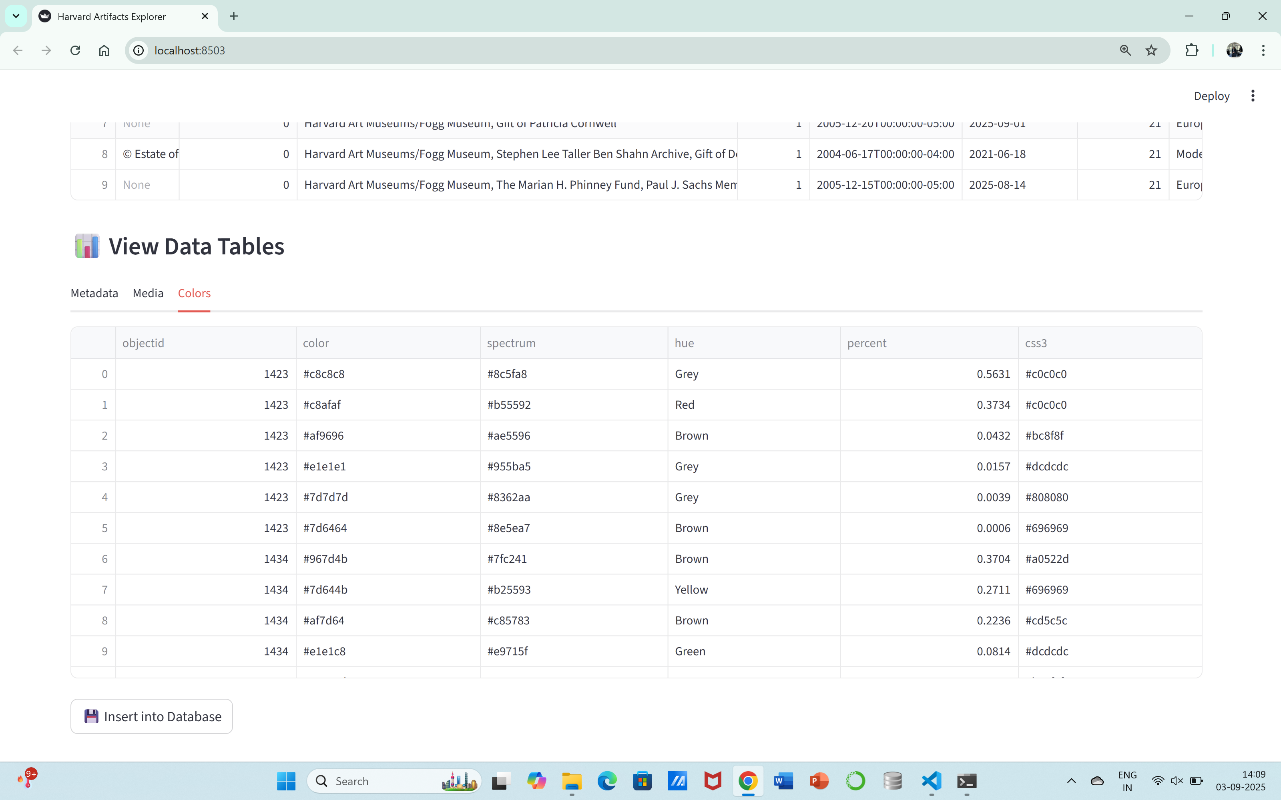
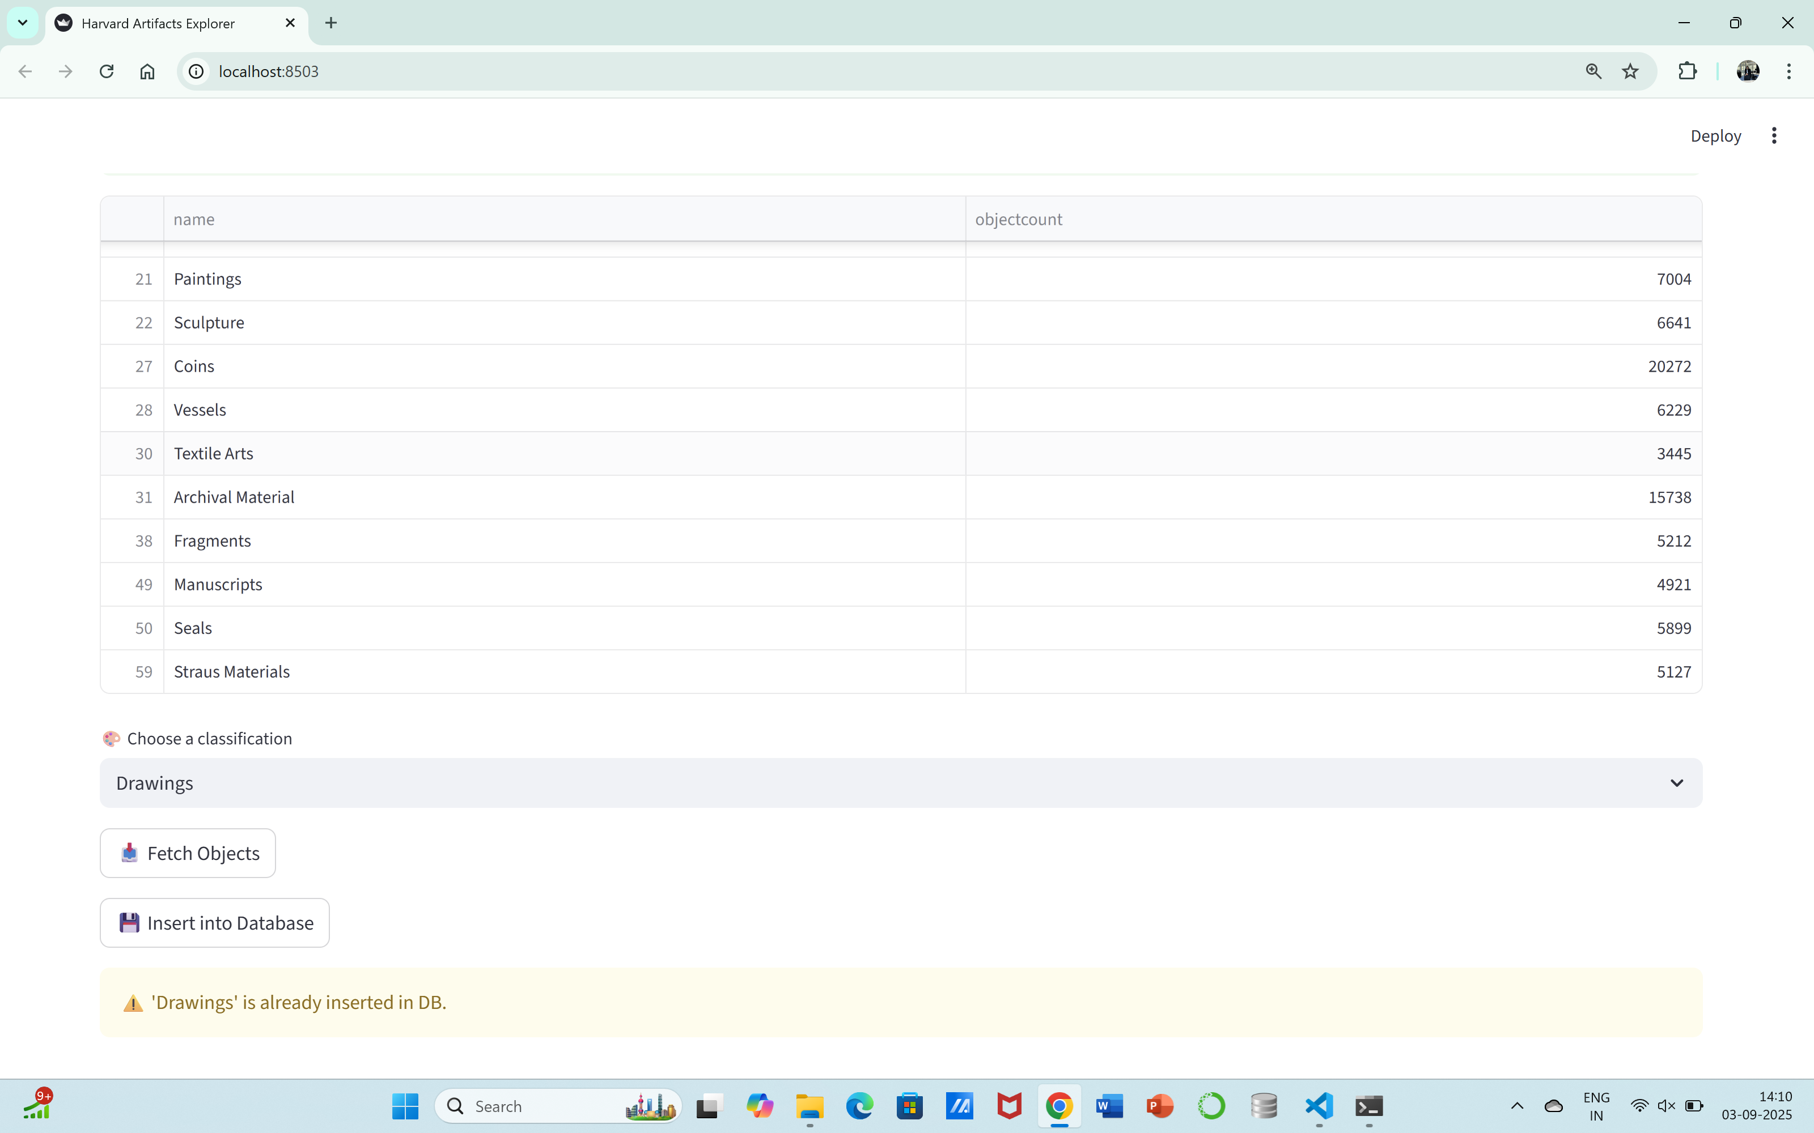

Slide 8
Queries Implemented
The application is implemented in Python with Streamlit providing an interactive frontend.
The workflow includes fetching data, splitting it into structured DataFrames, inserting into SQLite, and providing query execution options.
A dropdown-based query explorer allows users to select one of 30 SQL queries (20 predefined + 10 DIY) and view results instantly.

Slide 9
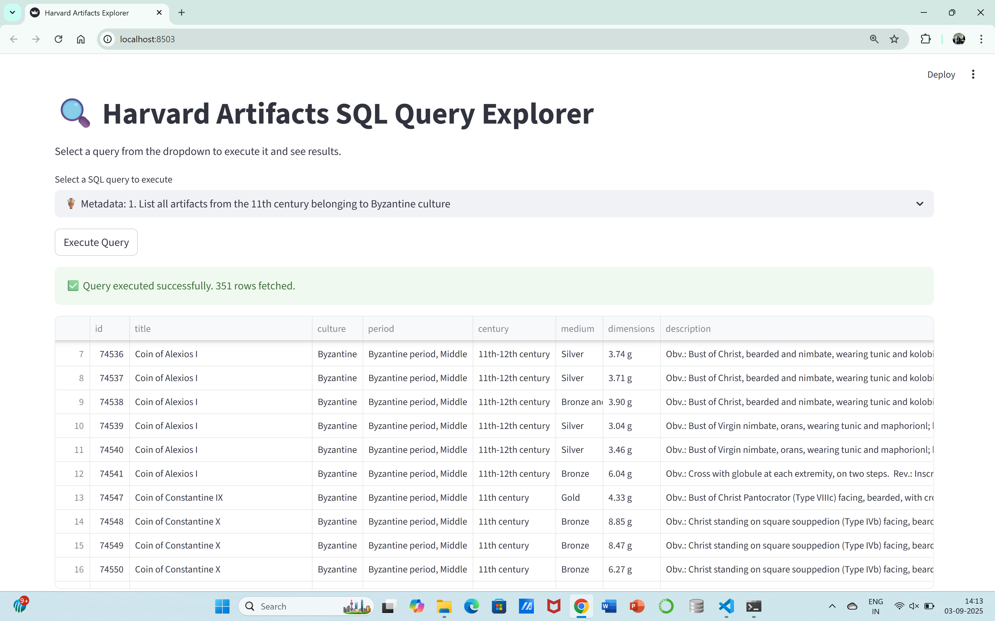
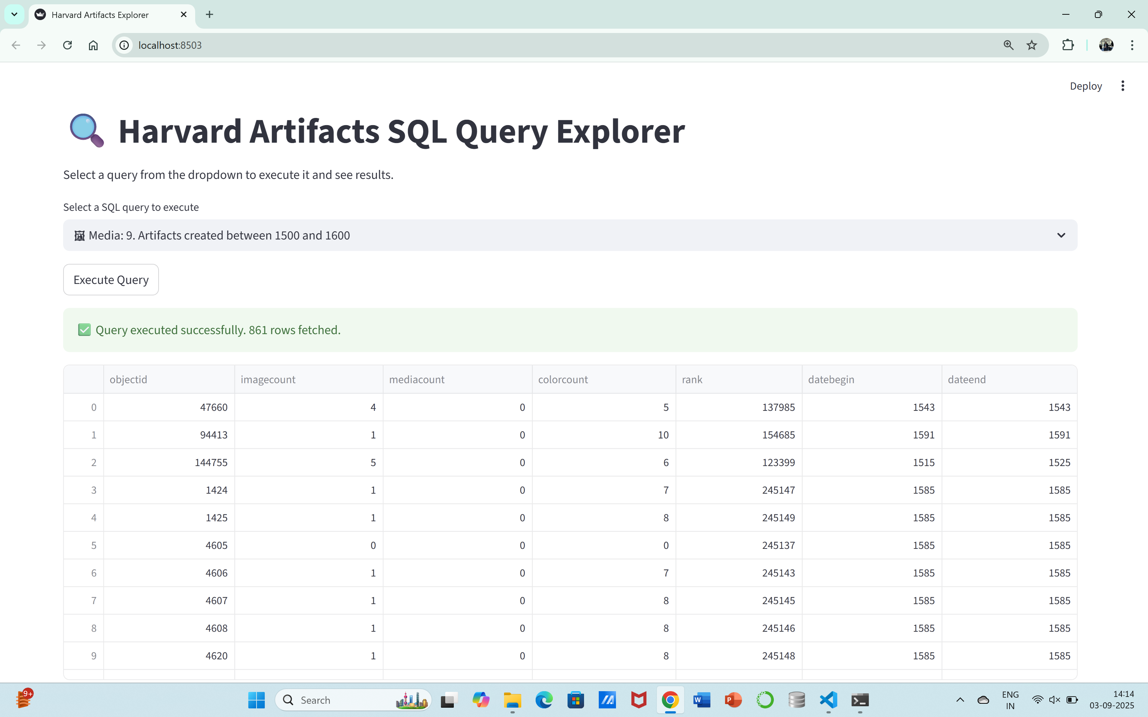
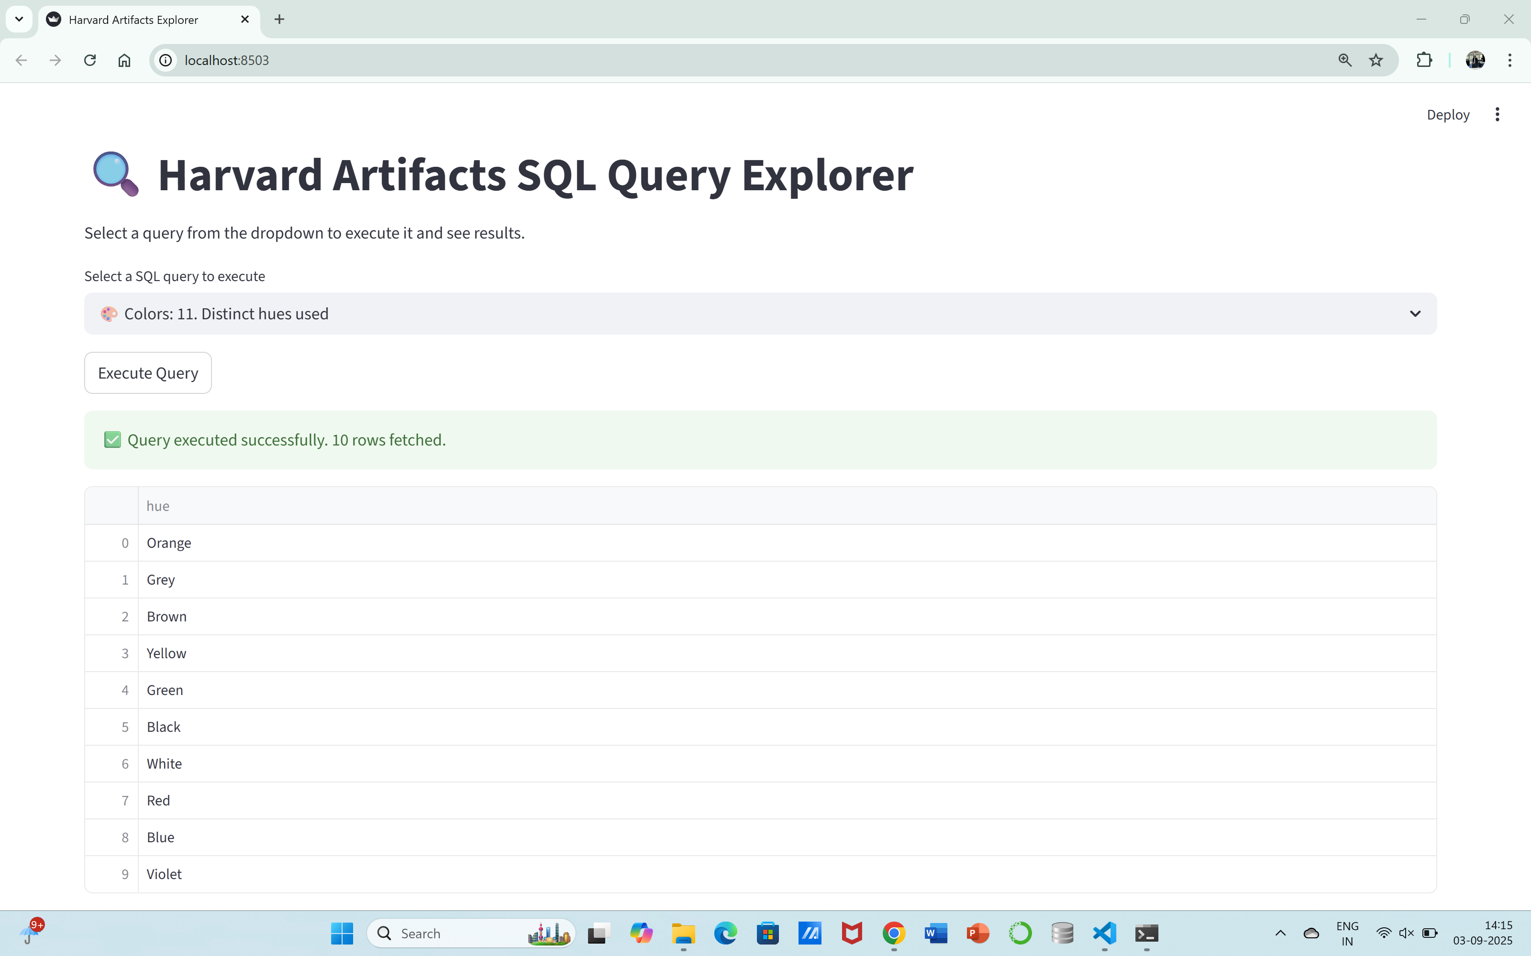
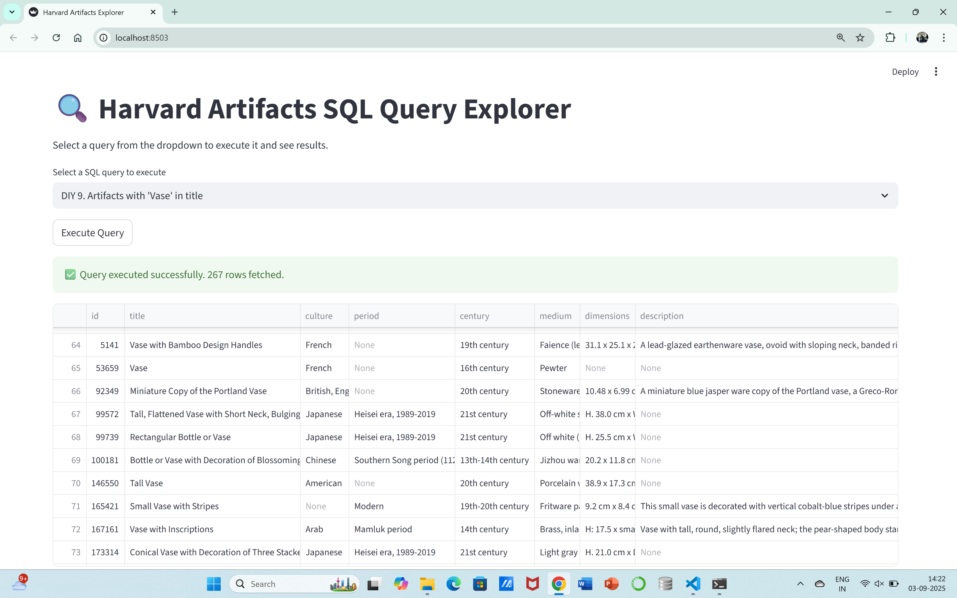

Slide 10
Results and Analysis
The project successfully demonstrates how real-world datasets can be fetched, stored, and analyzed interactively.
Key findings include: - The database contains thousands of artifacts across multiple cultures, centuries, and classifications. - Byzantine and Egyptian artifacts are richly represented. - Colors like Grey, Red, and Blue dominate in artifact imagery. - Join-based queries reveal detailed relationships between metadata, media, and color usage.

Slide 11
Conclusion
The Harvard Artifacts Explorer successfully integrates API data collection, database storage, and interactive SQL queries.
It provides valuable insights into cultural heritage collections and serves as a beginner-friendly project for data exploration.
This project can be extended further with advanced visualizations, deployment, and predictive analytics.

